Slide 1

C++
Strings and Standard Template Library

Slide 2
Table of contents Index / Agenda
Strings
c-strings vs. std::strings
String Initialization
Useful Methods
String Operations
Standard Template Library
Iterators
Vector
String
Map
Methods
STL and Polymorphism

Slide 3
c-strings vs. std::strings
c-string
In C, a string is simply an array of characters that always includes a binary zero (often called the null terminator) as its final array element.
Contains junk values on initialization.
std::string
In C++, string objects associate the array of characters which constitute the string with methods useful for managing and operating on it.
C++ strings are not null terminated.
Is empty on initialization
C++ strings are mutable

Slide 4
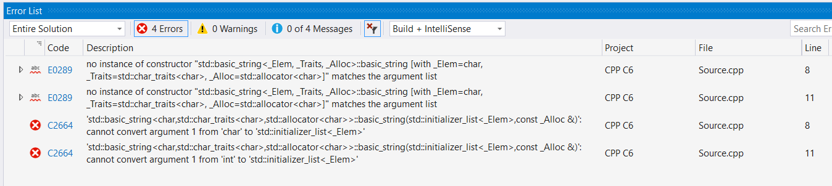
String Initialization
Strings can not be initialized with:
A single ASCII character
A numeric value
Strings can be initialized like this:
using namespace std;
// empty constructor
string s1; // s1 = "“
// initialization with c_string
string s2("abcdef"); // s2 = "abcdef“
// initialization with another string
// copy constructor
string s3(s2);
// initialization with a substring of an existing string
// copy from source s1 starting from position 1 until end
string s4(s1, 1); // s4 = "bcdef“
// initialization by copying a sequence from an existing item
// copy 2 characters from source s1 starting from position 3
string s5(s1, 3, 2); // s5 = "de“
// initialize all elements with a specific value
string s6(15, '-');
// can't be initialized with single character
std::string bad_str1('A');
// can't be initialized with numeric values
std::string bad_str2(32);

Slide 5
Useful Methods
Function | Description
length/size | Return length of string.
begin | Returns an iterator to the beginning
end | Returns an iterator to the end
append | Append to string
c_str | Get C string equivalent
find | Find content in string.
substr | Generate Substring
compare | Compare two strings

Slide 6
String Operations
// indexing
std::string s1("abc");
s1[0] = 't'; // s1 is now "tbc"
// assigning
std::string s2("def");
std::string s3("ghi");
s2 = s3; // s2 is now "ghi"
// appending
s1 = s1 + s2; // s1 is now "tbcdef"
// another append method
s2.append(s3); // s2 is now "ghighi“
s1 = "abc";
s2 = "ghi";
// equality
bool result = (s1 == s2); // false
result = (s2 == s3); // true
In c++, operator ‘==‘ checks for equality in two strings and returns a boolean value.
If you’re interested in how the two strings differ from one another, use compare.
// comparing
std::cout << s1.compare(s2) << std::endl;
// 0 if strings are equal
// <0 when the value of the first character that
// does not match is lower, or the compared
// string is shorter
// >0 when the value of the first character that
// does not match is higher, or the compared
// string is longer

Slide 7
String Operations
Insert makes sure the insertion of characters will not overwrite existing characters.
Replace automatically resizes the string to fit the size of the replacing string. The first argument tells the function where to start replacing, the second argument tells it how long the replacement string is and the third finally tells it what to replace with.
std::string myString("Hello world!");
// Attention! There is difference between ' ' and " "
std::string comma(",");
// insert second string at position 5
myString.insert(5, comma); // value is now: Hello, world!
Find, allows you to find a character or a sequence of characters in a given string.
// replace
std::string replacement("World");
// myString is "Hello World!"
myString.replace(myString.size(),
replacement.size(), replacement);
// myString is updated to "Hello World!World"
std::cout << myString;
size_t result;
// find a character or substring
result = myString.find(comma); // prints 5 first position
// where , is found
result = myString.find(comma, 6); // returns random value,
// there are no more , after
// position 5

Slide 8
Standard Template Library – Base Containers
Is a fundamental part of the C++ standard. It provides a set of highly efficient implemented tools that can be used in a wide variety of applications
STL contains five kinds of components: containers, iterators, algorithms, function objects and allocators.
A few important Containers:
Array(Cpp11): encapsulates a normal array and mimics its behavior. Provides methods useful for managing and operating on it.
Vector: represents arrays that can resize their storage capacity as needed.
Set: is a container that stores unique elements following a specific order.
Map: stores elements formed by a combination of key value and mapped value, following a specific order.
All STL containers are generic, they need to be told what type of values they will store when we declare them.

Slide 9
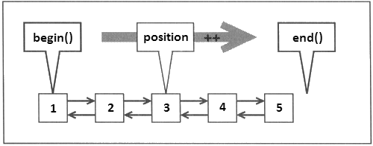
Standard Template Library - Iterators
What’s an iterator?
Iterators provide a way of specifying a position in a container. An iterator can be incremented or dereferenced, and two iterators can be compared.
All STL containers have methods that allows you to acquire an iterator that points to the first element (.begin()) or an iterator that points to “after the end” (.end()).

Slide 10
Standard Template Library - Vector
Iterating through a vector:
// a vector can be populated when declared
std::vector<int> myVector = { 1, 2, 3, 4 };
// elements can be appended at any time
myVector.push_back(5);
// getting an iterator of the container start
std::vector<int>::iterator startPos = myVector.begin();
// getting an iterator of the container end
std::vector<int>::iterator endPos = myVector.end();
// initialize a generic iterator and assign it to the
// value of the start of the container
std::vector<int>::iterator position = startPos;
// traverse the vector
while (position != endPos) // 1 2 3 4 5
{
// dereference the iterator to obtain the value
// it is pointing to
std::cout << *position << " ";
++position;
}
// delete 1 element from the end of vector
myVector.pop_back(); // 1 2 3 4
// delete 1 element found on given position
myVector.erase(startPos + 1); // 1 3 4
for (auto index : myVector)
{
std::cout << index << " ";
}

Slide 11
Standard Template Library - String
// iterating through string
std::string myString("Hello World!");
for (std::string::iterator it = myString.begin(); it != myString.end(); ++it)
{
std::cout << *it << " "; // displays: H e l l o W o r l d !
}
// getting the first character
std::string::iterator it = myString.begin();
std::cout << *it << " "; // displays: H
// access any character by providing a valid index
std::cout << myString[6]; // displays: W
// getting the last character
std::string::reverse_iterator r_it = myString.rbegin();
std::cout << *r_it << " "; // displays: !

Slide 12
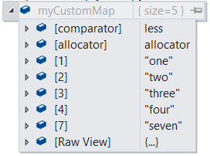
Standard Template Library - Map
Stores elements formed by a combination of a key and a mapped value
// Declare a map, the int represents the key value and the string represents the mapped value
std::map<int, std::string> myMap;
// universal initialization
std::map<int, std::string> myCustomMap{ {1, "one"}, {2, "two"}, {7, "seven"} };
// insert a value using the subscript operator
myCustomMap[3] = "three";
// create a new pair and insert it into the map
std::pair<int, std::string> myPair(4, "four");
myCustomMap.insert(myPair);
// Attention! The content of the map is sorted based on the key values.

Slide 13
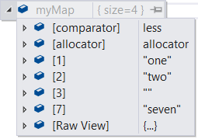
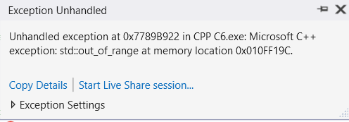
Standard Template Library - Map
// iterating through a map
std::map<int, std::string> myMap = { {1, "one"}, {2, "two"}, {7, "seven"} };
std::map<int, std::string>::iterator it;
for (it = myMap.begin(); it != myMap.end(); ++it)
{
// displays: 1, one; 2, two; 7, seven;
std::cout << it->first << ", " << it->second << "; ";
}
// getting a specific value through subscript operator
std::string value = myMap[1]; // get value "one"
// use a method to get the value
std::string otherValue = myMap.at(7); // get the value "seven“
// if a key does not exist, the subscript operator will return
// a reference to a new value
std::string newValue = myMap[3];
std::cout << newValue << " "; // displays empty value
// if the key does not exist, method "at" throws exception
std::string noValue = myMap.at(4);
// use find to check if a key exists
// also an iterator can be used to store
// the .find() result
if (myMap.find(4) != myMap.end())
std::cout << "key - pair found";
else
std::cout << "key does not exist";

Slide 14
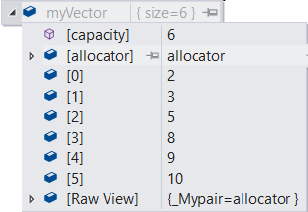
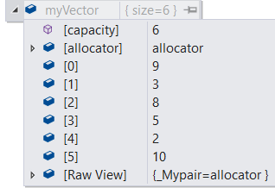
Standard Template Library – Methods
STL Algorithms: sort, random shuffle.
The sort method implements a variation of the quicksort algorithm.
// declare and initialize a vector
std::vector<int> myVector = { 2, 3, 5, 8, 9, 10 };
// mix elements randomly
std::random_shuffle(myVector.begin(), myVector.end());
// sort the elements in ascending order
std::sort(myVector.begin(), myVector.end());
for (auto index : myVector)
std::cout << index << ", ";

Slide 15
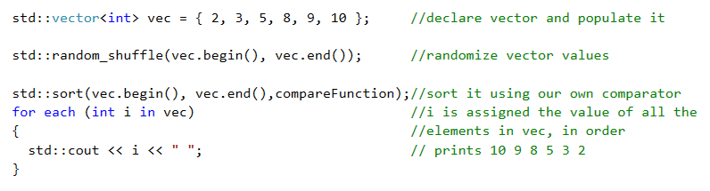
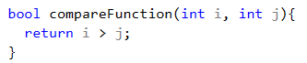
Standard Template Library – Methods
Personalizing STL algorithm methods:
In this case, we opt to sort it in descending order:

Slide 16
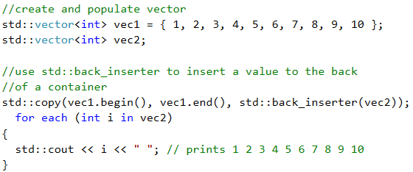
Standard Template Library – Methods
std::copy

Slide 17
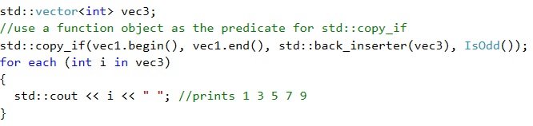
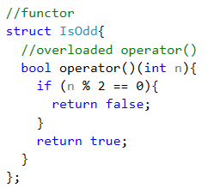
Standard Template Library - Methods
std::copy_if
A function object (functor) is a class or a struct that overloads operator(). That lets you create objects that “look like” a function. A benefit of using functors is that, unlike regular function, functors can have state.

Slide 18
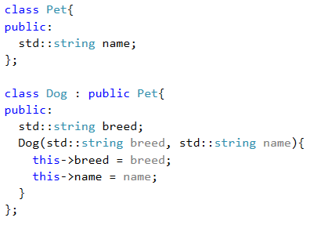
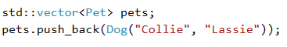
STL and Polymorphism
Derived class is automatically converted to its base class and added to the vector.
However, when upcasting like this, information is lost.

Slide 19
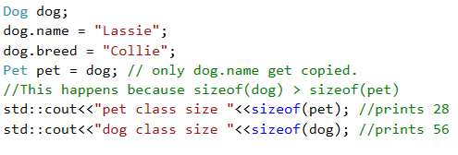
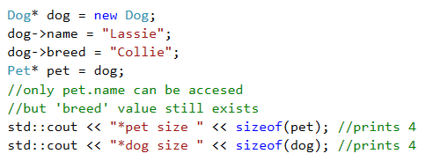
STL and Polymorphism
Non pointer upcasting:
Pointer upcasting:

Slide 20
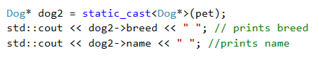
STL and Polymorphism
Downcasting:
In standard C++, no run-time type check is made to help ensure the safety of the conversion.
The static_cast operator can be used for operations such as converting a pointer to a base class to a pointer to a derived class. It will only perform the cast if the type types are related. If the types are not related, you will get a compiler error. The cast is executed at compile time.
The dynamic_cast operator executes the cast at runtime, and because of that, it is useful when combined with polymorphic types.
The dynamic_cast operator won’t give you a compile time error, if the types you are trying to convert are not related, it will return a NULL pointer.

Slide 21
STL and Polymorphism
Downcasting:
Converting a base class pointer to a derived class pointer.
Not allowed without an explicit cast
Upcasting:
Converting a derived class to its base class.
It is always allowed for public inheritance, even without explicit cast.
Parent Class
Child Class

Slide 22
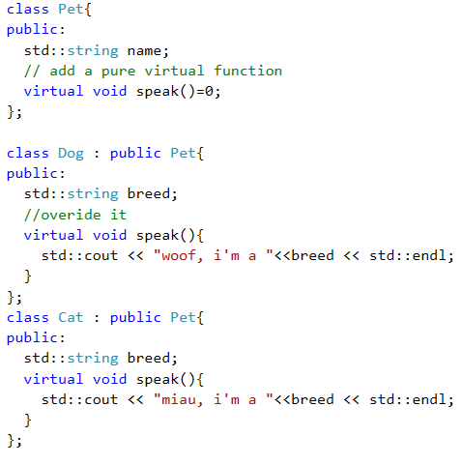
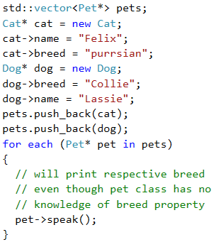
STL and Polymorphism

Slide 23
References
Video tutorial:
From C++ Tutorial for Beginners 76 – Object Oriented Design Considerations
To C++ Tutorial for Beginners 78 – Static Creating Libraries

Slide 24
Contact
Published by Siemens 2023
Ionuț Verzea
Software Engineer ADV D EU RO IFA MI
Blv. 15 Noiembrie Nr.78 500097 Brașov România
E-mail ionut.verzea@siemens.com
Petrescu Vlad Adrian
Software Developer ADV D EU RO ES TLS DI1
Blv. 15 Noiembrie Nr.78 500097 Brașov România
E-mail vlad.petrescu@siemens.com

